Slide 1
Voice Enabled Skill
Developed By :- Dilip Kukadiya

Slide 2
INTRODUCTION
Why Voice Is important to you

Slide 3
Conversation is the most Natural way to engage with your products.
Voice releases the friction of traditional technology interaction.
User can now interact with your product in more intimate way.

Slide 4
Agenda
Hosting places for skills
Research On Alexa skill –(Overview)
How she works –(Architecture)
Create Simple Alexa Skill for POC -1 –(Example)
Create Alexa Skill for Second POC - 2 –(Question Answer)
Create Survey Skill –(full survey)

Slide 5
Hosting your skill
Skills live in the cloud, and are hosted in one of two places.
1.AWS Lambda
2.An internet accessible HTTPS endpoint with a trusted certificate

Slide 6
Overview
I am creating multiple Alexa Skills using Lambda functions on the Amazon Web Services platform.
I am develop and customize this skill according to the client’s needs using the Lambda service.
I am creating a Survey skill in Alexa Using Amazon web service. There we will discuss.
This project will keep me busy for the next 3 to 4 months.

Slide 7
Amazon Alexa Echo!

Slide 8


Slide 9
Architecture?

Slide 10
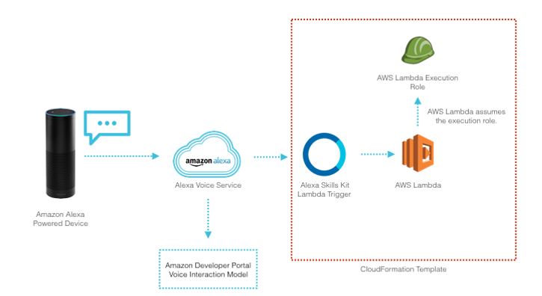

Slide 11
Simple Alexa Skill for POC
User: “Alexa, Open ‘Dilip Survey’
Alexa: “Welcome to ‘Dilip Survey’ what is your survey ID?”
User: “612020” - store whatever number is said here in the MongoDB Database
Alexa: “Excellent I have stored your survey ID in the Mongo DB Database! Would you like me to repeat your number?”
User: “Yes”
Alexa: “Your number is 612020”
**** If user states “No”
Alexa: “Have a nice day”
**** Close Skill

Slide 12
Alexa Skill for Second POC
User: 612020 – User Survey ID
Alexa: Question 1, On scale of 1 to 5, 1 being poor and 5 being excellent, please tell us, How satisfied were you with today's event?
User:4
Alexa: Question 2, On scale of 1 to 5, 1 being poor and 5 being excellent, please tell us, How likely did today's event meet your expectations?
User: 2
Alexa: Question 3, What did you like best about today's event?
User : All of that

Slide 13
Thank You

Slide 14
Questions?

